Slide 1
Hydropower Models
LTGen (Long Term Generation) – Central Valley Project (CVP) power operations
SWPGen (State Water Project Generation) - SWP power operations
Both models spreadsheet based
Rating formulas developed in VBA
Two abstraction units:
Power generation (i.e. reservoir generation)
Power use (i.e. pumping plants at head of canals)
Our job is to replicate these models in Jython for connection to a CalSim/CalLite output GUI

Slide 2
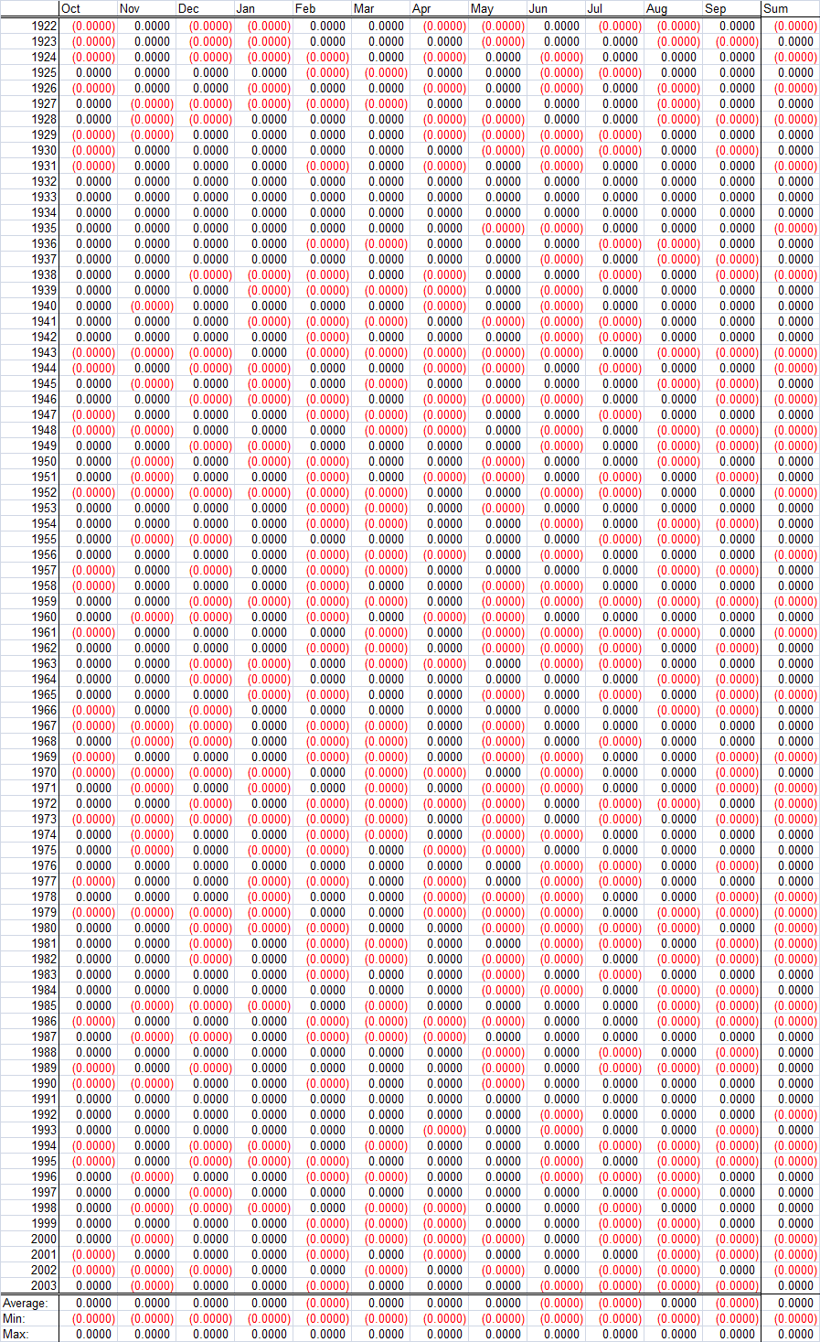
Trinity Power Plant Potential (GWh)
Difference is calculated as:
Spreadsheet minus Jython

Slide 3
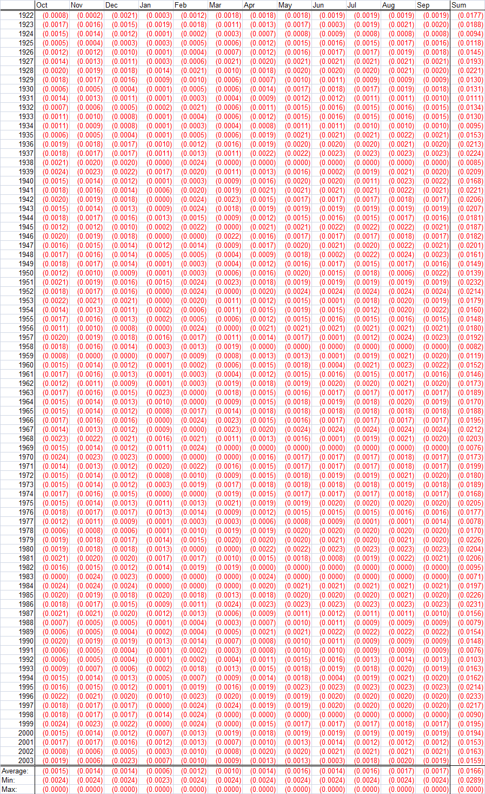

Alamo Power Plant Available Capacity (MW)
Difference is calculated as:
Spreadsheet minus Jython
Difference in numerical approximation between
Excel and Jython? Need to find out.

Slide 4
SWPGEN CalSim/CalLite Inputs

Slide 5
CVP LTGen CalSim/CalLite Inputs

